Slide 1
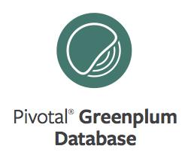
GPDB Command Center
Notes:
Intro: my name is, my role is, …

Slide 2
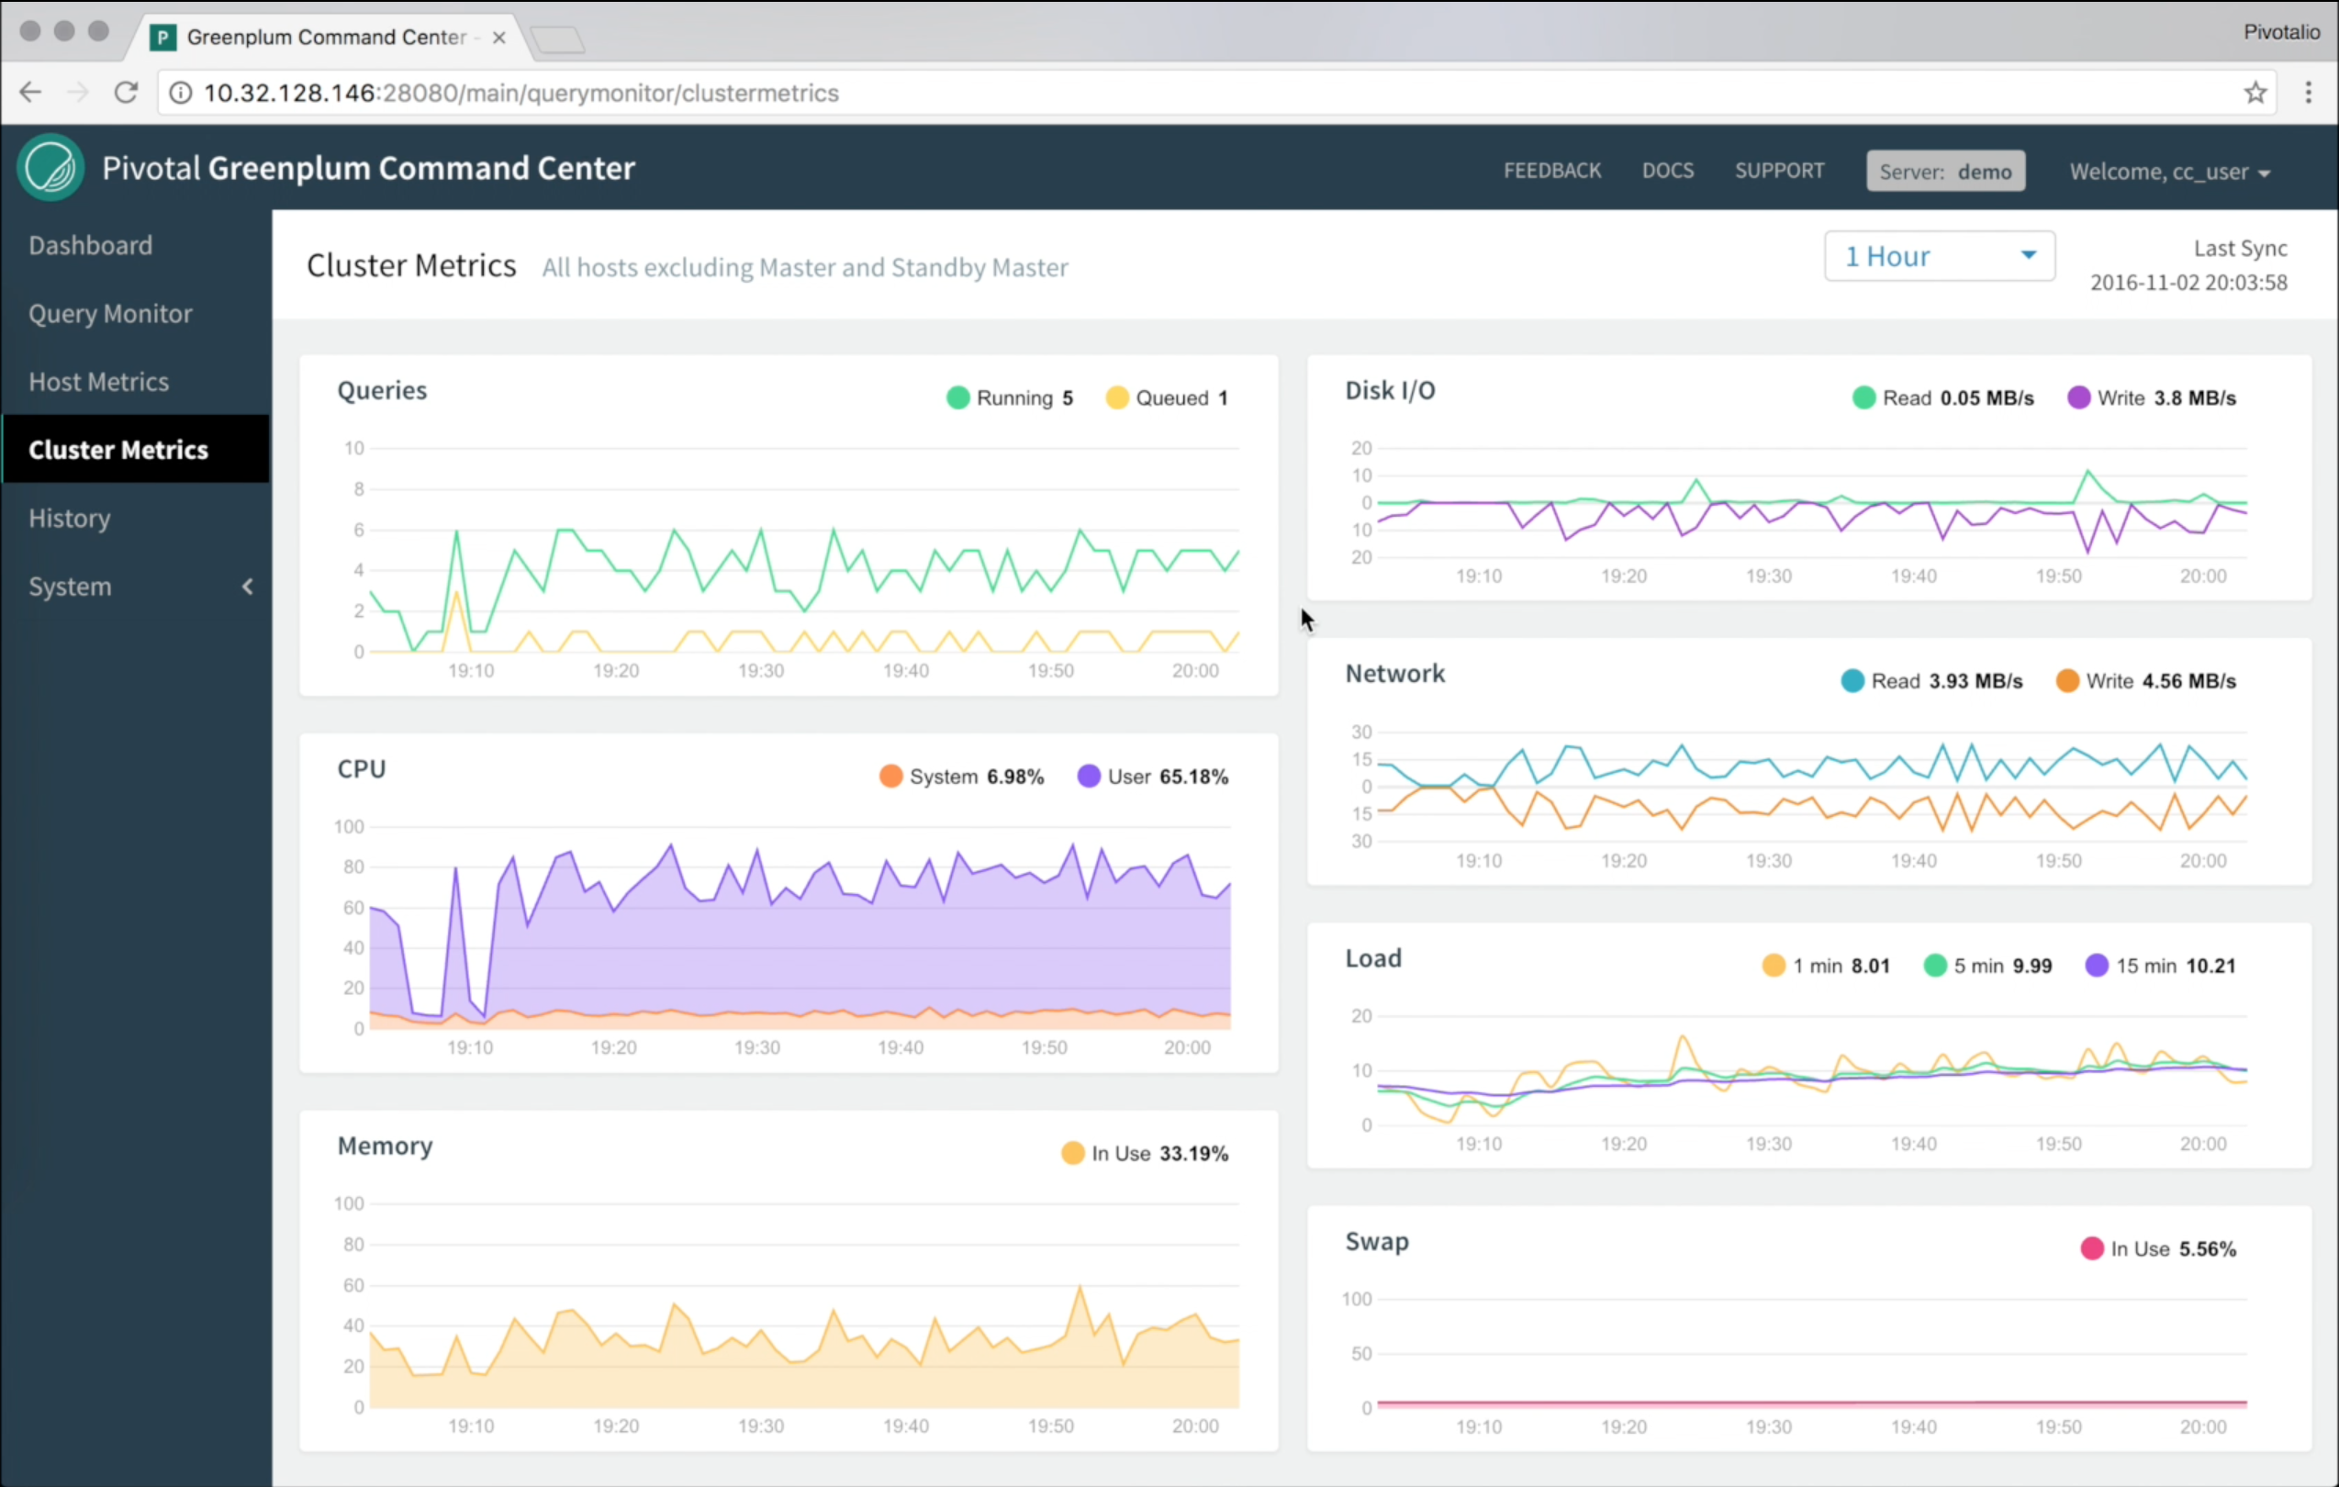
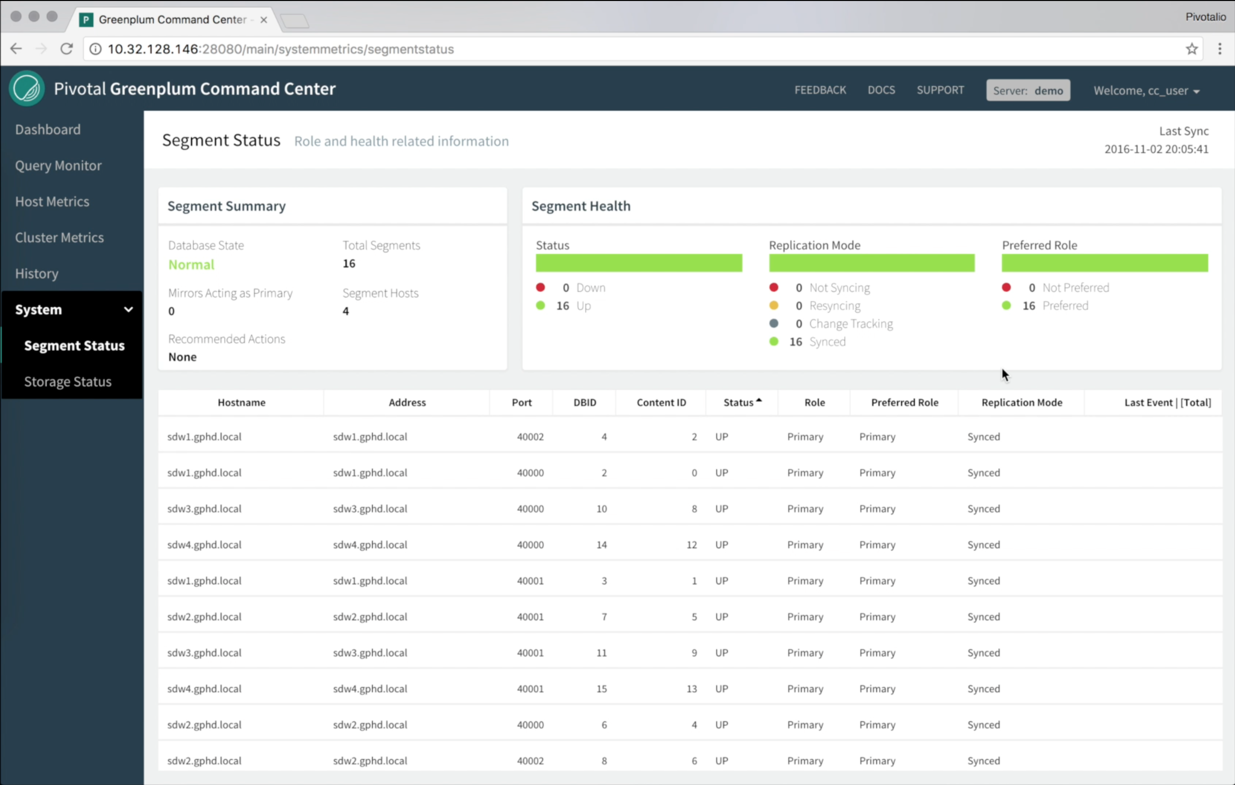
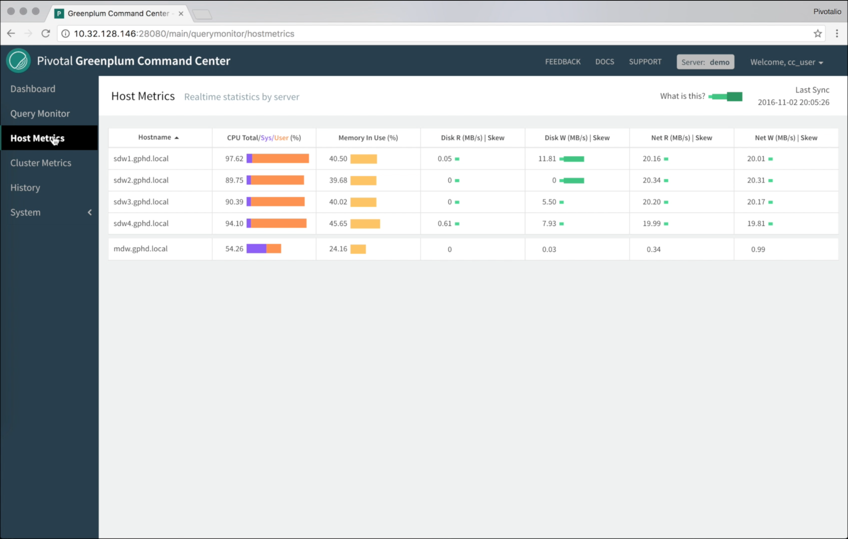
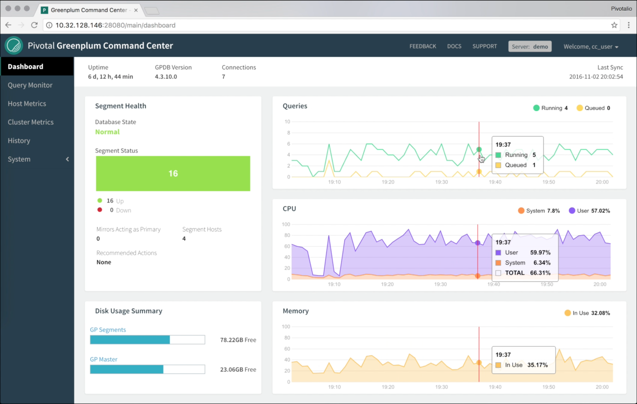
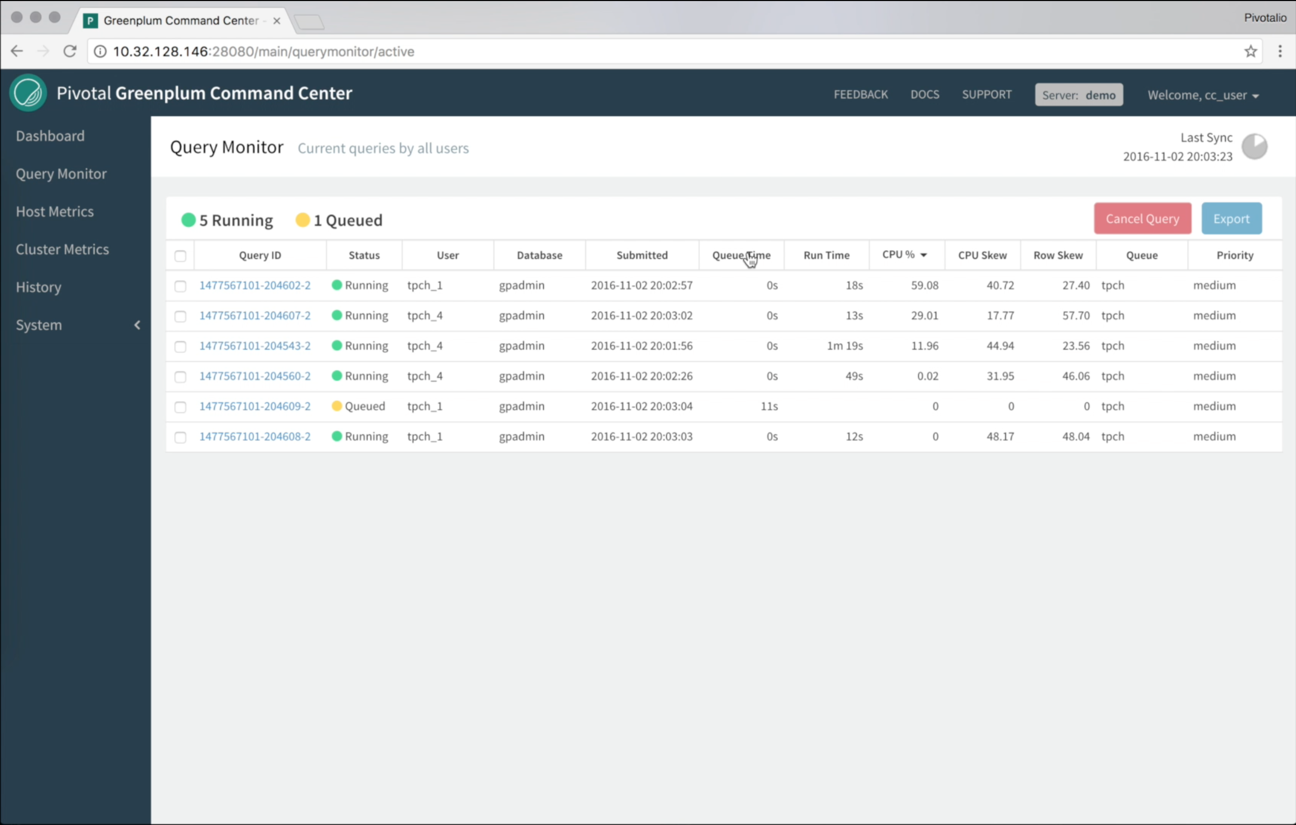
Greenplum Command Center Overview
Greenplum Command Center:
Collects system metrics and query details
Aggregates historical information
Monitors key metrics
Controls instance power
Modifies resource management
Cluster metrics
Segment Status
Host metrics
Dashboard
Query Monitoring
Notes:
You can use Greenplum Command Center to collect query and system performance metrics from a running Greenplum Database system. You can also perform several administrative tasks with this tool. You can track how the system performs over time as the Greenplum Command Center also stores historical information on system metrics.
Greenplum Command Center uses monitoring agents to collect information on all servers within the DCA system. The type of information collected includes:
CPU utilization
Queries running and queued
Memory utilization
System load
Disk I/O activity
Network throughput
Swap activity
Real-time performance per server
Detailed information on each query
Health monitoring details on each server and switch within the Pivotal DCA as well as the status of all components within those systems. This is available only when monitoring Greenplum Database on a Pivotal DCA.

Slide 3
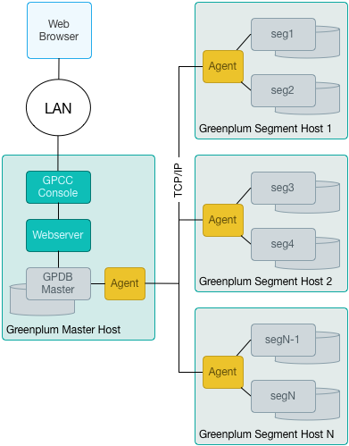
Greenplum Command Center Architecture
Greenplum Command Center:
Installs GPCC on Greenplum Master and Standby hosts
Installs GPCC Agents on all Segments (including the Master and Standby)
Collects system metrics and query details
Aggregates historical information
Monitors key metrics
Controls instance power
Modifies resource management
Notes:
You can use Greenplum Command Center to collect query and system performance metrics from a running Greenplum Database system. You can also perform several administrative tasks with this tool. You can track how the system performs over time as the Greenplum Command Center also stores historical information on system metrics.
Greenplum Command Center uses monitoring agents to collect information on all servers within the DCA system. The type of information collected includes:
CPU utilization
Queries running and queued
Memory utilization
System load
Disk I/O activity
Network throughput
Swap activity
Real-time performance per server
Detailed information on each query
Health monitoring details on each server and switch within the Pivotal DCA as well as the status of all components within those systems. This is available only when monitoring Greenplum Database on a Pivotal DCA.

Slide 4
Monitoring and Managing with Greenplum Command Center
Database queries and Hadoop jobs
Segment health
CPU usage
Alerts on system health and behaviors
System memory usage
Disk usage
Notes:
Greenplum Command Center is a monitoring and management interface for the Greenplum environment. It lets administrators monitor system metrics and access alerts, and also provides interactive dashboards for accessing detailed information on system health as well as monitoring and managing configuration parameters that affect workloads.
The user interface provides access to dashboards that allow you to view varying aspects of system and database behaviors.
Greenplum Command Center is available with each release of the Greenplum Database software starting with GPDB 4.2 service pack 1. It is also available with each release of the Pivotal DCA software starting with the same release.
The Dashboard is your first tab after logging into Greenplum Command Center and provides an overview of how the system is performing in real-time along with some historical trends.
You can obtain information on the CPU, any queries that are running or queued, the memory that is currently being used, overall load, disk, swap, and network performance.
You can also obtain information on active queries and the resources that they are consuming. From this page, you can drill-down into greater detail on each query.
When used to monitor and manage an environment installed on the Pivotal DCA, Greenplum Command Center provides an overview of the infrastructure, including overall and component health.

Slide 5
Cluster Metrics
Cluster Metrics provide greater details on system resources
Real-time metrics let you observe how queries are impacting the resources
Notes:
The Cluster Metrics tab allows you to see greater details on system resources, again showing the CPU resources, swap, network, disk I/O, memory usage, and system load. You can additionally view details by a specific metric or you can examine the real-time performance of the system as it is being used.
The Cluster Metrics tab will show historical information for a time period you specify, starting from an hour and extending up to a year, if the information is available. All data is stored in a separate database within the Greenplum environment and is available until manually purged.
The Cluster Metrics tab can give you a good understanding of when usage of the Greenplum Database is at a peak and what the impact at those times can be.
A great benefit to using the real-time metrics is to examine how one or more queries are affecting the resources. Information on the CPU resources, memory, disk read and write rate, and the network read and write rate gives you a clear picture on how queries are affecting the system. This can show if you have a balanced environment or if one or more servers tend to be working harder than others.
By displaying and tracking this information, you can determine if your data is balanced appropriately for the type of jobs that is being executed. When one set of segment servers appears to be dedicating more CPU cycles to a query, it tends to show that there is a processing skew. The same for disk read and write rates. Overall, the huge benefit that Greenplum offers is the ability to balance the load on systems based on the type of queries that are run. This tool helps you to visualize performance and act on it if necessary.

Slide 6
Interactive Management of Queries
Query monitoring screen
Notes:
With Greenplum Command Center, you can manage active queries on the Query Monitor tab. Previously with the Greenplum Command Center console, you could only view queries. With Greenplum Command Center, you can view the resources that a query is consuming and the user who initiated the query. By monitoring the query, you can determine whether or not the query is awaiting access to the active running queue, cancel queries, and view detailed information on the query plan associated with the query.
The Query Monitor tab lets you see which queries are actively running and queued and allows you to get detailed information on each of those queries. This is particularly effective when working with long running queries. Shorter queries may actually finish too quickly to have much, if any, information captured or even available in real-time analysis.
The active queries mini-dashboard allows you to see how much resources the query is using, the user issuing the query, and the database they are connecting to, the run time, CPU, and row skew. We will cover details on skewing later in the course.
Clicking the details icon lets you see the actual query content and system information on that query, including its priority in the run queue, and the application that was used to issue the command.
You are not only exposed to the explain plan for the query, but details on the query are displayed.
Now that we have discussed the main features and benefits of the Greenplum Command Center, let us take a look at the architecture.

Slide 7
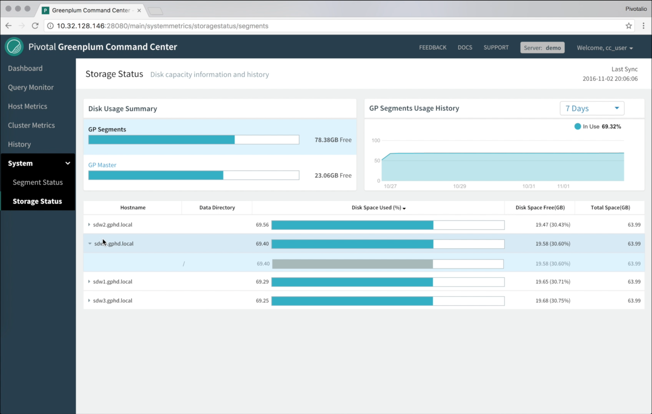
Segment Status and Storage Status Reports
Segment Status usage report
Storage Status reports
Notes:
You can monitor storage usage for the database by viewing database utilization reports and current storage utilization reports.
The database usage report lets you view how the disk is being utilized by the database, including the amount of disk space consumed by heap or regular tables, append-only tables, and column-oriented tables.
Storage monitoring lets you view the amount of disk space utilized by each server within the cluster. By actively keeping track of the disk space on each segment, an administrator can work to keep disk utilization below 70%. Filespaces are also easily identified within the storage utilization reports along with the actual filesystem or directory to which the filespace is associated.

Slide 8




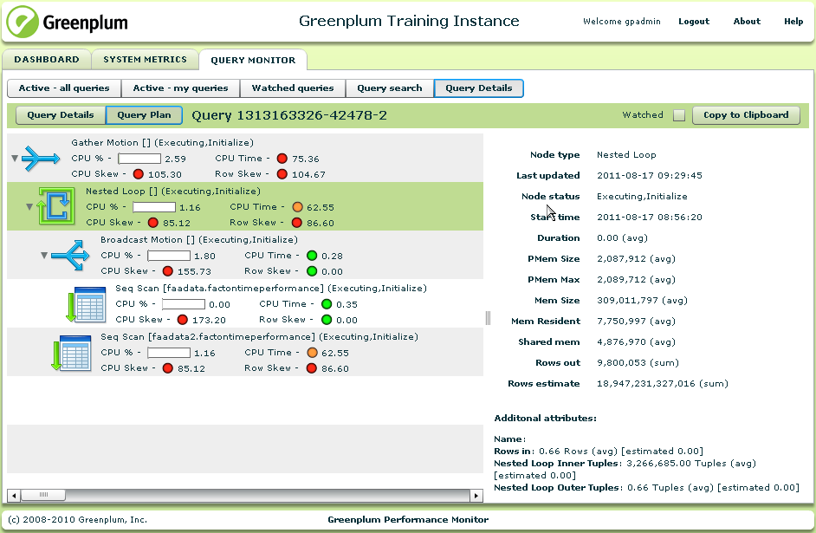




Greenplum Command Center Architectural Overview
Agent
Segment server
Master server
Console
Agent
Agent
Segment server
lighttpd web server
Agent
Command
Center DB
Segment server
Agent
Segment server
Notes:
Greenplum Command Center is comprised of:
Greenplum Command Center Console, a graphical browser interface which features the Greenplum Command Center Web Service, a lightweight lighttpd web server.
Greenplum Command Center data collection agents which run on the master and segment servers.
Greenplum Command Center database, gpperfmon, which is dedicated to storing and serving performance data.

Slide 9
Greenplum Command Center Console and Web Server
Supports HTTP and HTTPS
Agent
graphical console
Segment server
Master server
Master server
Console
Console
Agent
Agent
Agent
Segment server
lighttpd web server
lighttpd web server
Agent
Command Center DB
Segment server
Lightweight, open-source web server
Agent
Segment server
Notes:
The Greenplum Command Center Console consists of a flash-based graphical console accessed through a browser and used to view performance metrics for all servers in the cluster. You can access separate Greenplum instances from the console by assigning each instance its own unique port ID.
The console queries the monitor database through a web service framework that consists of a lightweight lighttpd web server and a Python-based middleware infrastructure. This web service framework is an open-source web server with low-memory and low-CPU load requirements.
The console can be accessed through HTTP or HTTPS protocols that you enable when installing and configuring the console. The console can be installed on the master server or on a remote server that can access the master server.

Slide 10
Greenplum Command Center Agents
Agent
Polls every 15 seconds by default
Agent
Segment server
Master server
Console
Agent
Agent
Agent
Agent
Segment server
lighttpd web server
Agent
Agent
Command Center DB
Segment server
Change interval setting in $MASTER_DATA_DIRECTORY/gpperfmon/conf/gpperfmon.conf to 10, 15, 20, 30, or 60
Agent
Agent
Segment server
Notes:
The Greenplum Command Center agent on the master server polls all agents on other servers in the DCA for performance data. By default, this occurs every 15 seconds. The interval can be changed by updating the quantum variable in the gpperfmon.conf file stored in the $MASTER_DATA_DIRECTORY/gpperfmon/conf directory. Decreasing the interval lets you collect additional data for system metrics, allowing you to capture shorter running queries. Keep in mind however that decreasing the interval can potentially crowd out other queries.

Slide 11
Greenplum Command Center Database
Command Center stores the data collected by the agents in to the gpperfmon database under the gpmon role.
Master server
Master server
Agent
Agent
lighttpd web server
lighttpd web server
Performance Monitor DB
Lightweight, open-source web server
Command
Center DB
Notes:
The Greenplum Performance Database, gpperfmon, stores and serves performance data collected by the agents. Data is stored across three types of tables:
Tables with _now appended to the end of the table name are external tables that pull information from data files stored in the $MASTER_DATA_DIRECTORY/gpperfmon/data directory. The files contain data on current metrics collected during the period between when data are collected from the monitor agents to when the same data are committed to the database.
Tables with _tail appended to the name are external tables that contain transitional information cleared from the now tables that have not yet been committed to the database itself. These tables typically contain a few minutes worth of data.
Tables with _history appended to the name are regular tables that are partitioned into monthly partitions and contain all the information gathered from the tail tables.
Note that while the gpperfmon database can provide historical data, it should not be used for accounting as it does not trap all events that has happened. What you are seeing is a sampling provided over a period of time. This is to prevent Greenplum Command Center from hogging system resources which could preventing or delaying other queries from running in a timely manner.

Slide 12
Greenplum Command Center Data Flow
Change on install or in postgresql.conf with the parameter, gpperfmon_port
gpsmon
Agent
Segment server
Master server
Port 8888
Console
Agent
gpsmon
Agent
Segment server
Port 28080
gpmmon
lighttpd web server
gpsmon
Agent
API calls
Command Center DB
Segment server
Master server port (5432)
gpsmon
Agent
Segment server
Notes:
A client accesses the console through the port for the instance defined. By default, port 28080 is made available for assignment. Each instance you define must have a unique port. Once the connection has been established, API calls to the Command Center database retrieve current and historical information and make the data available to the graphical console. You can view the same information by using client programs such as psql or through JDBC or ODBC.
The agent on the master, gpmmon, is responsible for gathering information from the agents on the segment servers, gpsmon. The agent on the master communicates with these agents over TCP/IP on port 8888 by default. The port number can be changed while installing Greenplum Command Center or after installation by modifying the gpperfmon_port parameter in the postgresql.conf file on the master, standby, and segment servers.
Information is written to now files which are available to the external tables. After a period of time, data collected in the now files are written to the tail files. This information will eventually be committed to the Command Center database, gpperfmon.

Slide 13

Configuring Greenplum Command Center
1
Enable the agents, install the database, create the role
If necessary, install and configure the Command Center Console
Validate the configuration
2
3
Agent
Agent
Port 28080
Console
Console
lighttpd web server
Command Center DB
Command Center DB
(gpperfmon)
gpmon role
gpperfmon_install
Notes:
You perform three main tasks when enabling Greenplum Command Center:
Enable the Greenplum Command Center collection agents, create the Greenplum Command Center database, and create the superuser for the Command Center database. This step is performed by the gpadmin user with the gpperfmon_install command. During the installation, you specify the password for the Greenplum Command Center superuser role, gpmon, that will be created.
If you are installing the Greenplum Command Center Console on a remote system, you will use the gpccinstall command to do so. Otherwise, the console has already been installed on the master server. The console allows you to configure a separate Command Center instance for each database instance you will be monitoring. Remember, the database instance is not the user database, but is instead the Greenplum Database instance you installed within the environment. After the console has been installed, you can create provide users with specific roles to access the console. You will then start the Greenplum Command Center instance you created.
Validate the installation was successful. This final step is used to ensure you can log into the environment and validate that information is being collected for the Greenplum environment.

Slide 14
Configuring the Standby Server
If necessary, install and configure the Command Center Console
2a
Console
lighttpd web server
Use gpperfmon_install to install binaries to primary master
Install binaries to the standby server
2b
2c
Copy the $MASTER_DATA_DIRECTORY/ pg_hba.conf file from the master to the standby
Use gpccinstall to install binaries to standby master
lighttpd web server
2d
Console
Copy ~gpadmin/.pgpass from the master to the standby
Notes:
During the setup process, you are given the opportunity to setup Greenplum Command Center on the standby server. If you plan on being able to access Greenplum Command Center from the standby server should the master server become unavailable, you must install the software to the standby server. In the event the master server becomes unavailable, the standby server can service requests for Greenplum Command Center.
To perform the installation, first, populate a file with the host names of each server for which you would like to install the Greenplum Command Center binaries. Each server hostname must be on a line by itself and must be resolvable.
Assuming the filename is gpcc_hosts, the command to perform the installation is:
$ gpccinstall -f gpcc_hosts
After installing the software, you will also need to synchronize your copy of the $MASTER_DATA_DIRECTORY/pg_hba.conf file on the master with the standby server. This ensures that all of the required connections are also available if you need to connect using the standby server.
A last step is to copy the ~gpadmin/.pgpass file from the master to the standby master. This is the authentication file for Greenplum Command Center. The permissions must be set to 0600 (read-only for the owner).

Slide 15
Greenplum Command Center Users and Roles
Superuser
Operator
Regular User
Uses all Command Center features
Can view all database queries
Can access all metrics
Can perform all administrative tasks
This is a role that you must create in Greenplum
Assign GPDB users to the role
Can view and cancel all queries
Limited administrative task access
All GPDB users have access
Can only view their own database queries
Cannot access the Administrative tab
Requires MD5-encrypted password by default
Notes:
There are three main types of users that can access the Command Center console. These include:
Superuser – Users assigned the Greenplum Database SUPERUSER attribute have full access to all features and tabs within the console. This user can view all database queries and system metrics. By default, the gpadmin user is assigned the SUPERUSER attribute. The gpmon user is granted the SUPERUSER attribute and therefore has full access to all features of the console. This database user was created as part of the installation process and is used to manage Greenplum Command Center components and data . The gpmon user should not be used for logging into the console. This user is protected with MD5-encrypted password by default.
Operator – The operator role must be created after installing Greenplum Command Center. The role, gpcc_operator, can then be granted to users to provide them with operator permissions. These permissions include viewing and canceling all queries, whether they are owned by the user or not. This user cannot stop or start the database, make changes to workload management parameters, or change resource queues.
Regular User – All other users which do not have the SUPERUSER attribute and are not a part of the operator role have access to the Greenplum Command Center console with the ability to manage their own database queries. They cannot view or access queries associated with other users.
Greenplum Command Center requires MD5-encrypted password authentication by default. Greenplum Database and Command Center both support SHA-256 and so can be used instead.

Slide 16
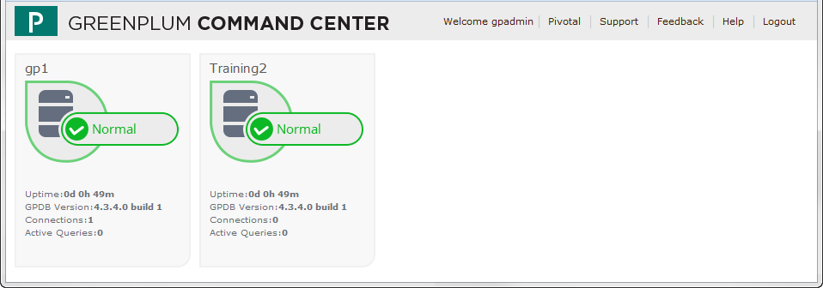
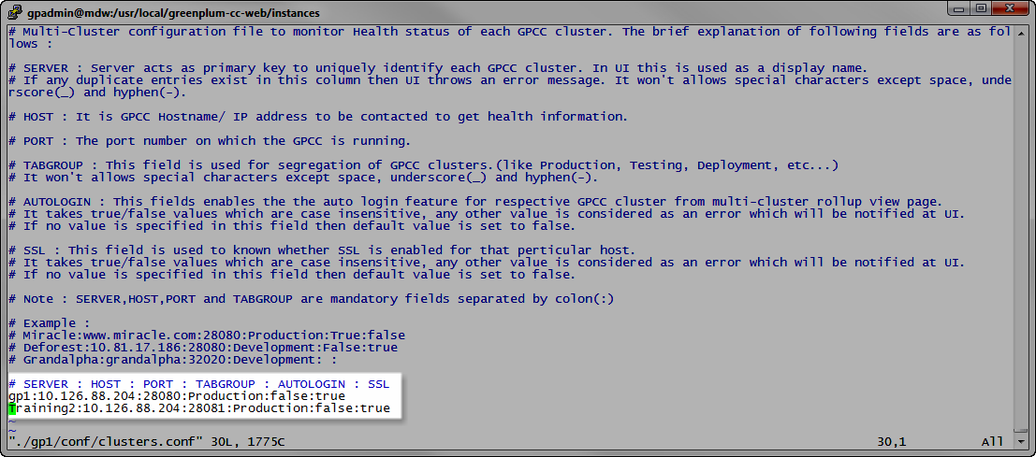
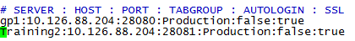
Multi-Cluster Support
Click Multi-Cluster link after updating clusters.conf file
Notes:
Greenplum Command Center provides a multi-cluster support, where you are able to obtain a quick view of the status of all the Greenplum Database clusters you monitor with Greenplum Command Center.
For multi-cluster support, you choose a Greenplum Command Center instance to act as the master. From this master instance, you can view the Multi-Cluster page which provides a status of the instance.
You can launch the user interface for each of the individual instances you manage.
To configure multi-cluster support, modify the $GPPERFMONHOME/instances/<instance_name>/conf/clusters.conf file and add each cluster you wish to monitor. An example is shown on the screen.
There are a few items to note when modifying the file:
The first field is the unique ID for the instance. This is how it will be displayed on the Multi-Cluster page.
The second field takes a resolvable hostname or IP address
The third field contains the port number for the instance
The fourth field allows you to categorize the clusters into different groups
The last two fields are not case sensitive. However, the only valid values are true or false.
All hosts you are defining must have the same SSL configuration. They must all either have SSL enabled or disabled.
Autologin support is available and uses the username and password you used to log into the master instance.
Once the file has been updated, you can access the Multi-Cluster page from the Multi-Cluster link when you login to the master instance.

Slide 17
Defining and Managing Console Instances
gpcmdr Option | Description
--setup | Configure a unique Greenplum Command Center instance
--restart [instance] | Restart Greenplum Command Center instance(s)
--start [instance] | Start Greenplum Command Center instance(s)
--stop [instance] | Stop Greenplum Command Center instance(s)
--status [instance] | Display Greenplum Command Center instance information
Instance information is stored in $GPPERFMONHOME/instances/<instance_name>
Notes:
The gpcmdr command is used to define and manage Greenplum Command Center instances. Once defined using the gpcmdr --setup command, configuration information for the instance is stored in the $GPPERFMONHOME/instances/<instance_name> directory.
You can start, stop, and restart instances with the gpcmdr command. You can identify a single console instance to manage by specifying the instance name, or manage all services by not specifying an instance name.

Slide 18
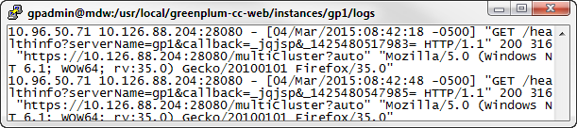

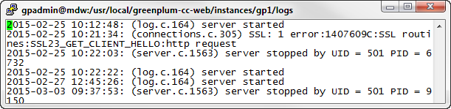
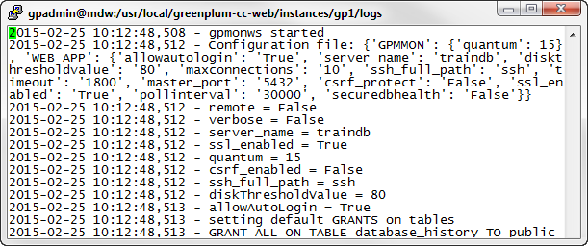


Accessing Console Log Files
lighttpd-access.log
lighttpd-error.log
gpmonws.log
Notes:
Errors and access information are written to log files within the instance directory. The log files, stored in $GPPERFMONHOME/instances/<instance_name>/logs, are:
lighttpd-access.log contains the access information to the instance
lighttpd-error.log contains any errors for the instance
Authentication errors can be found in the log file, gpmonws.log, in the same directory. The log contains a trail of the configuration parameter values and permissions for the instance from the time the instance was created and for each start and restart of the instance.
The file locations for the access and error log files are defined in $GPPERFMONHOME/instances/conf/lighttpd.conf.
The log files can be maintained with an external log control utility such as logrotate or cronolog.

Slide 19
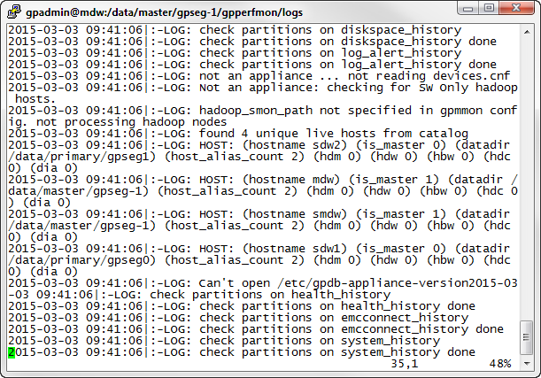
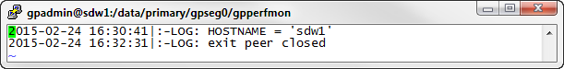
Accessing Agent Log Files
gpmmon.log
gpsmon.log
Notes:
Log files for the master agent are stored as $MASTER_DATA_DIRECTORY/gpperfmon/logs/gpmmon.<timestamp>.log. This contains messages highlighting communications to other cluster agents.
Agent log files for the master and standby master are stored in the same directory as gpsmon.<timestamp>.log. On segment hosts, the log files are written to the same filename but are stored in the first segment’s data directory. For example, in our class configuration, the files are stored in /data/primary/gpseg0/gpperfmon. The agent log contains any specific logging information pertaining to that agent.
The log size is maintained by the max_log_size parameter in the $MASTER_DATA_DIRECTORY/gpperfmon/conf/gpperfmon.conf file. The value of this parameter is measured in bytes.
The log alert level can be adjusted by modifying the gpperfmomn_log_alert_level parameter which is stored in the $MASTER_DATA_DIRECTORY/postgreql.conf file. Use the gpconfig command to change the alert level from its default of warning to any other valid levels.

Slide 20
Lab: Install and Configure Pivotal Greenplum Command Center
In this lab, you install Greenplum Command Center and validate that it was successfully installed.
You will:
Enable the Greenplum Command Center agents
Install the Greenplum Command Center Console
Configure the Greenplum Command Center Console and enable access to the console for gpadmin
Notes:
In this lab, you enable the Greenplum Command Center agents and install the Greenplum Command Center Console. After configuring the console, you will explore the environment, issuing commands to verify that the environment has been successfully installed and configured.

Slide 21
Lab: Navigating Pivotal Greenplum Command Center
In this lab, you install Greenplum Command Center and validate that it was successfully installed.
You will:
Navigate the Pivotal Greenplum Command Center dashboards
Obtain information on the Greenplum environment using the tabs
Notes:
In this lab, you use Pivotal Greenplum Command Center to obtain information on the Greenplum environment, monitor specific aspects of the environment, and reset the environment.

